Slide 1
Pipeline Processing
Pipelining is a technique for breaking down a sequential process into various sub-operations and executing each sub-operation in its own dedicated segment that runs in parallel with all other segments.
The most significant feature of a pipeline technique is that it allows several computations to run in parallel in different parts at the same time.

Slide 2
Let us consider an example of combined multiplication and addition operation
A_{i}* B_{i} + C_{i} for i = 1, 2, 3, ......., 7
The operation to be performed on the numbers is decomposed into sub-operations with each sub-operation to be implemented in a segment within a pipeline.
The sub-operations performed in each segment of the pipeline are defined as:
R1 ← A_{i}, R2 ← B_{i} Input A_{i}, and B_{i}
R3 ← R1 * R2, R4 ← C_{i} Multiply, and input C_{i}
R5 ← R3 + R4 Add C_{i} to product

Slide 3
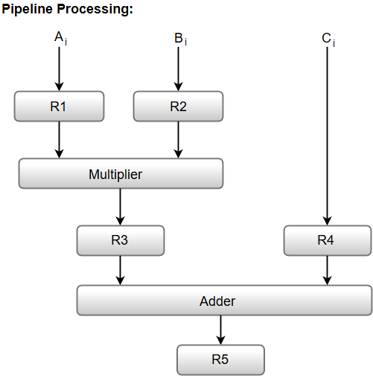
The following block diagram represents the combined as well as the sub-operations performed in each segment of the pipeline.

Slide 4
The pipeline is applicable in two areas of computer organization:
Arithmetic Pipeline
Instruction Pipeline

Slide 5
Arithmetic Pipeline
It is designed to accelerate the implementation of arithmetic operations particularly specializing in improving the overall performance of mathematical computations.
Components
Addition Stage: In this stage, the pipeline plays the addition operation. It's a crucial mathematical operation and is frequently broken down into sub-parts for efficient processing.
Multiplication Stage: For more complicated mathematics operations, which encompass multiplication, an intense level is covered in the pipeline. Multiplication consists of a sequence of partial products, and an arithmetic pipeline can simplify this device.
Division Stage: Division is another arithmetic operation that can take advantage of pipelining. Dividing may involve more than one step, and breaking down the approach into pipeline ranges can decorate the general tempo of execution.

Slide 6
Advantages of Arithmetic Pipeline
Parallelism in Arithmetic Operations: Arithmetic pipelines take advantage of parallelism by breaking down complex operations into small parts. This allows the concurrent execution of a couple of arithmetic operations, considerably enhancing throughput.
Optimized Resource Utilization: The pipeline structure allows for the best usage of processing resources. While one arithmetic operation is within the multiplication stage, any other can be within the addition stage, maximizing the performance of the processor.
Enhanced Computational Speed: By dividing arithmetic operations into smaller, feasible phases, the overall pace of computation is expanded. This is mainly critical in programs in which mathematical calculations are a large element, which includes medical computing or photograph processing.

Slide 7
Instruction Pipeline
An instruction pipeline receives sequential instructions from memory while prior instructions are implemented in other portions. Pipeline processing can be seen in both the data and instruction streams.
In general, each and every instruction must be processed by the computer in the following order:
1. Fetching the instruction from memory
2. Decoding the obtained instruction
3. Calculating the effective address
4. Fetching the operands from the given memory
5. Execution of the instruction
6. Storing the result in a proper place

Slide 8
Each step is carried out in its own segment, and various segments may take different amounts of time to process the incoming data. Furthermore, there are occasions when multiple segments request memory access at the very same time, requiring one segment to wait unless and until the memory access of another is completed.
If the instruction cycle is separated into equal-length segments, the organization of an instruction pipeline will become much more efficient. A four-segment type of instruction pipeline refers to one of the most common instances of this style of organization.

Slide 9
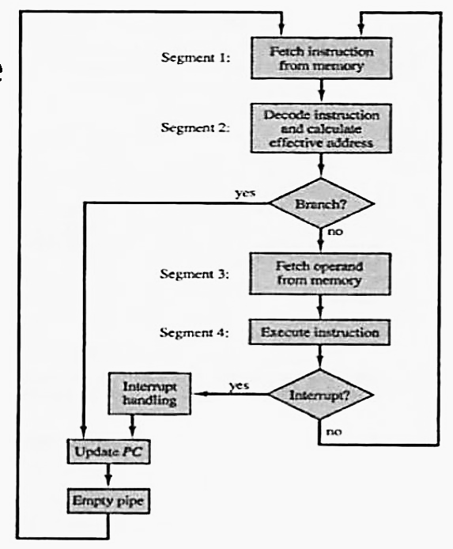
Flowchart of instruction Pipeline
Segment 1
The implementation of the instruction fetch segment can be done using the FIFO.
Segment 2
In the second segment, the memory instruction is decoded, and the effective address is then determined in a separate arithmetic circuit.
Segment 3
In the third segment, some operands would be fetched from memory.
Segment 4
The instructions would finally be executed in the very last segment of a pipeline organization.

Slide 10
Components:
Instruction Fetch (IF): The first stage involves fetching the instruction from memory. The software program counter is used to decide the address of the following approach.
Instruction Decode (ID): In this phase, the fetched instruction is decoded to determine the operation to be completed and to understand the operands involved.
Execution (EX): The actual computation or operation through the instruction takes place in this stage. It might also additionally contain mathematics or logical operations.
Memory Access (MEM): If instruction requires access to memory, this stage is wherein data is analyzed from or written to memory.
Write Back (WB): The final phase includes registering the results once more to report or memory and finishing the execution of these.

Slide 11
Advantages:
Improved Throughput: The instruction pipeline allows for a continuous drift of commands through the processor, enhancing the usual throughput. While one instruction is within the execution phase, every other may be within the decoding phase, resulting in better resource utilization.
Faster Program Execution: By overlapping the execution of instructions, the time taken to execute a series of commands is reduced. This outcome in faster software execution is a vital element in enhancing the general performance of a PC system.
Effective Resource Management: Instructional pipelining allows powerful manipulation of sources by permitting tremendous levels of the pipeline to operate concurrently. This contributes to a good and streamlined execution of commands.

